Slide 1
Introduction to Data Science Data Mining for Business Analytics
Brian d’Alessandro
VP – Data Science, Dstillery
Adjunct Professor, NYU
Fall 2014
Fine Print: these slides are, and always will be a work in progress. The material presented herein is original, inspired, or borrowed from others’ work. Where possible, attribution and acknowledgement will be made to content’s original source. Do not distribute, except for as needed as a pedagogical tool in the subject of Data Science.
Notes:
https://www.youtube.com/watch?v=aMDe5pODkB0 (harlan harris)

Slide 2
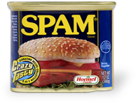
Lets build a dataset for spam filtering

Slide 3
Spam – target & Sampling
What is the Target Variable?
What does it look like?
How do we know if an email is spam or not?
What is the likely distribution of the target variable? How should we sample it?

Slide 4
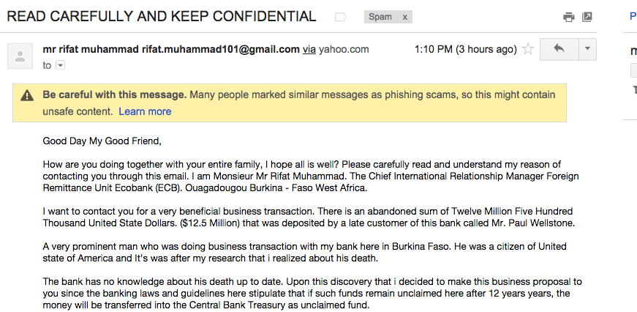
Spam – features
Lets look at an example spam and identify aspects that give it away.
How should we encode these as features?

Slide 5
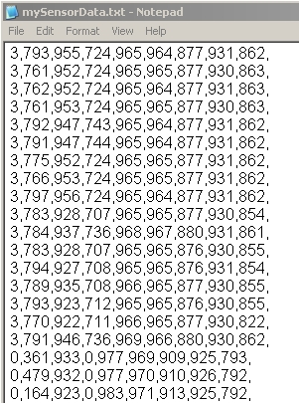
Spam – feedback loop
Congrats, you are ready to update your SPAM filter!
Now lets anticipate what could go wrong, including negative feedback loops.
Filter => P(Spam|Email)
No
Yes
User sees inbox, gives feedback
User ignores, no feedback
In
BOX
SPAM BOX
Analyst pulls training data from labeled inbox feedback

Slide 6
Spam – feedback loop
Congrats, you are ready to update your SPAM filter!
Now lets anticipate what could go wrong, including negative feedback loops.
Questions:
If the training data is pulled only from labeled Inbox, is selection bias likely? Why?
Should you put some SPAM in the user’s inbox so that you can get more training labels?
Filter => P(Spam|Email)
No
Yes
User sees inbox, gives feedback
User ignores, no feedback
In
BOX
SPAM BOX
Analyst pulls training data from labeled inbox feedback

Slide 7
Text feature extraction
Notes:
The goal of finding structure is to information from one source to reduce uncertainty about another source.
What does this mean? Conditional distribution example. I.e., carnival guy who guesses your weight. If I can see your height I can reduce uncertainty about weight.
Find some height/weight data.
Under supervised exploration:
How can we (automatically) obtain a selection of the more informative variables with respect to predicting the value of the target variable?
Even better, can we obtain the ranking of the variables?
Can think of importance as one that makes the target variable more pure. This leads to the notion of entropy.

Slide 8
Raw text
This is how text usually comes…
Doc | Phrase
1 | the cow jumped over the moon
2 | somewhere over the rainbow
3 | over the moon
Though this isn’t exactly useful in ML applications.

Slide 9
tokenizing
A very straightforward and scalable way to deal with text is to convert individual words to tokens, and let each token be a separate feature in the data.
Original Data Representation
Feature Dictionary
Doc | Phrase
1 | the cow jumped over the moon
2 | somewhere over the rainbow
3 | over the moon
Token | FID
cow | 1
jumped | 2
moon | 3
over | 4
rainbow | 5
somewhere | 6
the | 7
Tokenized Data Representation
(Binary Representation)
 | FID
Doc | 1 | 2 | 3 | 4 | 5 | 6 | 7
1 | 1 | 1 | 1 | 1 | 0 | 0 | 1
2 | 0 | 0 | 0 | 1 | 1 | 1 | 1
3 | 0 | 0 | 1 | 1 | 0 | 0 | 1

Slide 10
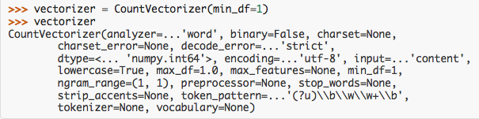
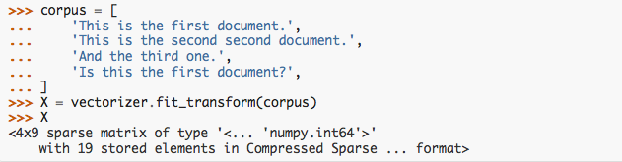
Tokenizing - python
http://scikit-learn.org/stable/modules/feature_extraction.html
1. Instantiate an object of type CountVectorizer
2. Fit a sequence of texts
3. Returns data in a sparse matrix format.

Slide 11
Sparse format
By default, sklearn.feature_extraction.text returns matrices in “sparse” format. In many applications, especially text, there are many features but each instance only has a relatively few non-zero values. We can define a format that does not explicitly store zeros to save space.
Sparse Format
(Explicit Values)
Doc | Sparse Features
1 | 1:1 2:1 3:1 4:1 7:1
2 | 4:1 5:1 6:1 7:1
3 | 3:1 4:1 7:1
Dense Format
 | FID
Doc | 1 | 2 | 3 | 4 | 5 | 6 | 7
1 | 1 | 1 | 1 | 1 | 0 | 0 | 1
2 | 0 | 0 | 0 | 1 | 1 | 1 | 1
3 | 0 | 0 | 1 | 1 | 0 | 0 | 1
Sparse Format
(Implicit Values)
Doc | Sparse Features
1 | 1 2 3 4 7
2 | 4 5 6 7
3 | 3 4 7

Slide 12
Extentions - ngrams
To gain more flexibility in our feature representation, we might want to tokenize parts of words, as opposed to the words themselves. I.e.,
2-grams
[“ra”, “ai”, “in, “nb”, “bo” ,”ow”]
“rainbow”
3-grams
[“rai”, “ain”, “inb, “nbo”, “bow”]
Each n-gram can then be considered an individual feature.
To build n-grams in sklearn:
>>> vect = CountVectorizer(min_df=1, analyzer='char', ngram_range=(2,2))
>>> X = vect.fit_transform(corpus)

Slide 13
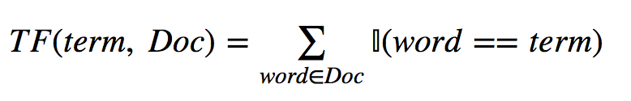
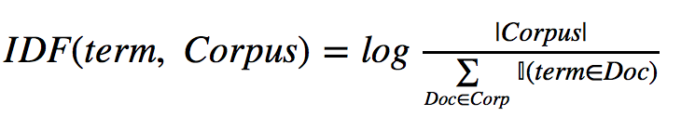
Extentions – tf/idf
In many cases we want more than binary indicators that a particular word/ngram is present in the document. One popular method, TF/IDF, assigns a heuristic importance weight of each word/ngram to each document.
Term frequency measures how many times a particular token appears in a particular document, and gives an indication of how important that word is to that document.
Inverse document frequency measures how often a word appears across all documents. It produces a measure that penalizes words that appear frequently.

Slide 14
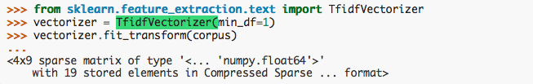
tf/idf - sklearn
TF-IDF can be implemented directly with tokenization using the sklearn.feature_extraction.text.TfidfVectorizer class.
Variations:
TF-IDF row vectors can be rescaled to have unit norms
TF can be calculating using a binary indicator of (freq>0) or log(freg)
IDF can be augmented to prevent division by zero
The optimality of TF-IDF is of course an empirical question.
Testing is always recommended!

Slide 15
Naïve bayes
Notes:
The goal of finding structure is to information from one source to reduce uncertainty about another source.
What does this mean? Conditional distribution example. I.e., carnival guy who guesses your weight. If I can see your height I can reduce uncertainty about weight.
Find some height/weight data.
Under supervised exploration:
How can we (automatically) obtain a selection of the more informative variables with respect to predicting the value of the target variable?
Even better, can we obtain the ranking of the variables?
Can think of importance as one that makes the target variable more pure. This leads to the notion of entropy.

Slide 16

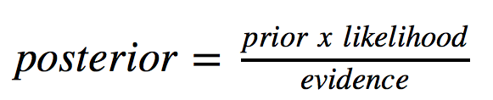
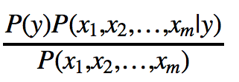
Bayes rule
In classification we want to estimate:
If we remember Bayes rule:
So mathematically:
How many parameters must we estimate for the above model?

Slide 17

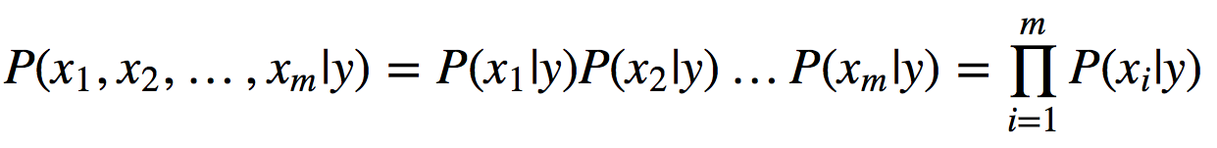
The naïve part
We make one assumption that simplifies our estimation problem tremendously. This is that each feature is independent of each other, condition on Y=y. Mathematically, this translates to:
We now apply this conditional independence assumption to the joint distribution of X given Y=y.
Why do we make this assumption?

Slide 18

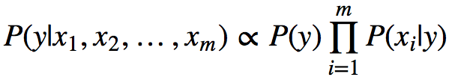
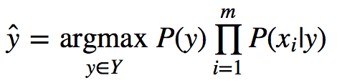
Constructing a classifier
We start with the fact that is constant given the data (and also not dependent on the class value).
Which leads us to this relation for each value of Y=y:
We then add a decision rule, which is to choose the value of y that is the most probable. This leads to the following maximum a posteriori decision rule:

Slide 19

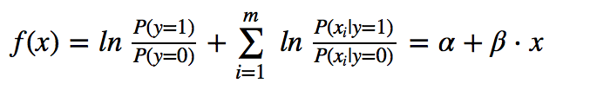

Nb as a linear model
We can position NB as another type of linear model. Assuming balanced classes, the previous optimization problem can be expressed as:
And using Bayes rule again, the log of the quantity in the above indicator function can be written as:
Which makes our NB estimator:

Slide 20
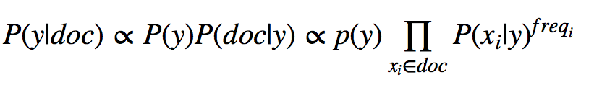

Variations of nb
Multinomial Naïve Bayes
In MNB we assume each document is characterized by a set of words/tokens (here called x_{i}, and that each word/token has a weight (usually frequency of occurrence or tf-idf for the document).
The posterior distribution is given by
P(x_{i}|y) is a smoothed maximum likelihood estimate, where N_{yi} is the document count of a word given y, N_{y} is the document count of all words given y, α is a smoothing parameter (usually=1), n is count of
all words.
We can use this to define a decision rule:
With the weight w_{i} being either the frequency or the tf-idf score of the word/token in the given document.
References: http://scikit-learn.org/stable/modules/naive_bayes.html,
“Tackling the Poor Assumptions of Naive Bayes Text Classifiers”, Rennie et al, ICML-2003

Slide 21
Variations of nb
Bernoulli Naïve Bayes
In BNB, each word/token x_{i} is a binary indicator, where w_{i} indicates that x_{i} is in a given document. The posterior distribution is then given by:
In this scenario we explicitly account for the fact that a given x_{i} is not in a particular document, and P(x_{i}|y) is again the smoothed maximum likelihood estimate that word x_{i} appears in a given document given y.
Our decision function is then.
References: http://scikit-learn.org/stable/modules/naive_bayes.html,
“Naive Bayes and Text Classification I”, Sebastian Raschka

Slide 22



Variations of nb
Gaussian Naïve Bayes
GNB is the standard formulation for continuously valued features. Again we use the following decision rule:
We make the assumption that X_{i} is distributed as a normal random variable:
Where:
References: http://www.cs.cmu.edu/~tom/mlbook/NBayesLogReg.pdf
Generative and Discriminative Classifiers: Naïve Bayes and Logistic Regression

Slide 23
Notes/advantages
Naïve Bayes fast and scalable
estimates each parameter separately
can handle sparse data and is easily parallelized
No numeric optimization – just counting (easy in a query language)
Good classifier, bad as a generative model
if Naïve assumption holds, NB is a Bayes optimal classifier
Naïve assumption never holds, so P(Y|X) tends to be biased towards 0 or 1
Nonetheless, works well under 0/1 loss
Sparsity Can Hurt You
P(x|y) needs to be smoothed, usually with beta-prior on the binomial distribution (LaPlace smoothing)
Class Imbalance
Binary decision rule works best when classes on rough equal
Will always pick dominant class in practice if high skew exists
Can use posterior estimate of P(Y|X) (or log) to rank and then use ROC to define optimal cut-off point.

Slide 24
Smoothing P(X)
Notes:
The goal of finding structure is to information from one source to reduce uncertainty about another source.
What does this mean? Conditional distribution example. I.e., carnival guy who guesses your weight. If I can see your height I can reduce uncertainty about weight.
Find some height/weight data.
Under supervised exploration:
How can we (automatically) obtain a selection of the more informative variables with respect to predicting the value of the target variable?
Even better, can we obtain the ranking of the variables?
Can think of importance as one that makes the target variable more pure. This leads to the notion of entropy.

Slide 25
Smoothing a probability
In the MNB, we added a little extra to the standard MLE of a Bernoulli probability.
What is this and where did it come from?
What is the motivation?

Slide 26
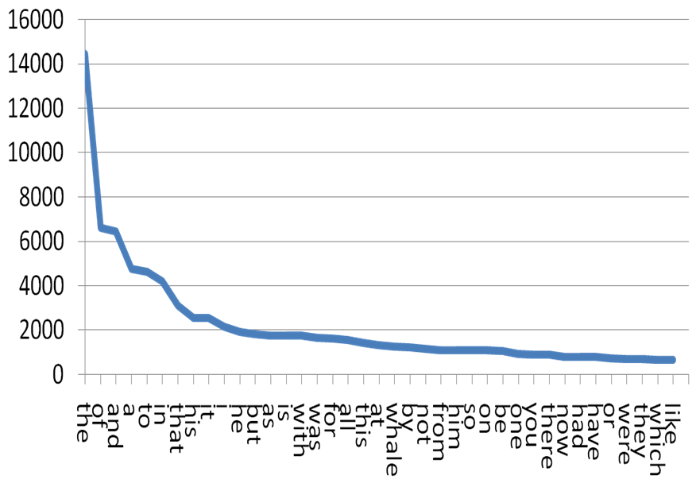
Popular words != Interesting
Let’s assume we want P(Word|Y=y). The most popular words in a book/text appear often enough that we can trust our estimate of P(Word|Y=y).
But popular words are often the least discriminative, i.e., P(Word|Y=y)=P(Word)
Top Word Count: Moby Dick
Source: http://searchengineland.com/the-long-tail-of-search-12198

Slide 27
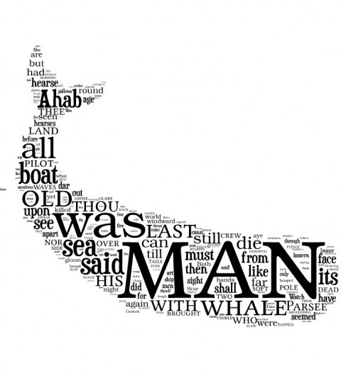

Sparsity is interesting
What we usually want are the rare words, like “whale”, “ahab” and “harpooner”
What if we wanted to classify book reports as relating to Moby Dick based on text in the report? We might estimate parameters like:
Source: http://ahistoryofnewyork.com/2013/01/moby-dick-big-read-day-117/

Slide 28

Probability estimation
Estimating a probability just amounts to counting.
But rare words (events) pose many problems with probability estimation:
Divide-by-zero: If the number of samples is low, sometimes the word/event won’t ever be observed, so the probability is zero.
High-variance: the variance of a probability estimate is p(1-p)/n. If n or p is low, our estimate won’t be very trustworthy. Think about if a word was observed once in a sample. If by chance another example came in with the word, the probability estimate of the word will double!

Slide 29

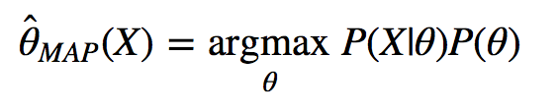
smoothing
We fix these problems with a Bayesian method called “smoothing.”
We add extra elements to the numerator and denominator to “smooth” or “shrink” the probability estimate (towards some prior belief of the probability).
The smoothed estimate is a Maximum a Posteriori estimate of the probability:
Where P(X|θ) = s/n is the likelihood and P(θ) is a carefully chosen prior.

Slide 30
Choosing a prior
We can use a prior that assumes X and Y are independent, so P(X|Y=y) = P(X).
We can also choose that P(X|Y=y) is equal to some previously estimated quantity
We can assume that P(X) = ½, just because.
We can also assume that P(X) is uniform for all X (i.e., every word in a document has equal probability).
We will introduce Dirichlet and Beta priors to accommodate all of the above. Ultimately, the optimal prior is an empirical question that can be evaluated using a hold-out set.
Notes:
Not done

Slide 31


Words as a multinomial
We can think of a word in a corpus as a multinomial discrete random variable X, that can take one of any words in the vocabulary. The likelihood of a particular x_{i} is simply the number of times x_{i} appears over the total possible occurrences of any X.
This has the constraint that:
We can see that this is how Multinomial Naïve Bayes is set up. Now, in many cases Ni might be low due to the rarity of the word. We thus want to set up the appropriate prior to smooth our estimate of P(x_{i}).
Notes:
Not done

Slide 32
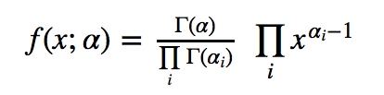

Dirichlet prior
The conjugate prior of the Multinomial distribution is the Dirichlet distribution, given by:
Given this prior, the MAP estimate of P(x_{i}) is then:
If we choose α_{i}=1, then α = |vocabulary|. This assumes a prior that x_{i} is uniform (i.e., all words have an equal prior probability).
Reference: http://research.microsoft.com/pubs/69588/tr-95-06.pdf
Notes:
Not done

Slide 33


Beta distribution
The beta distribution is the conjugate prior of the Bernoulli distribution. It is a special form of the Dirichlet distribution, where X has only two discrete values. The Dirichlet prior has a specific application to Naïve Bayes because X is often defined as a multinomial. In many cases we only want to deal with a binary random variable, which makes the beta distribution appropriate.
Uses the Gamma function to normalize.
Has same algebraic form as the Bernoulli distribution.
The mean of the beta distribution is given by:

Slide 34


The beta prior
The beta prior gives us greater flexibility to incorporate any prior belief in the probability of X (i.e., a word) occurring. With the beta prior, we assume the prior belief that P(X) is given just by the beta distribution, i.e.:
Which then is incorporated as:
The beta prior gives us the ability to estimate our prior directly from the data. I.e., if we want μ = P(X), we can estimate P(X) from the data. We control the degree of smoothing by choosing α and solving for β. The higher α, the more we assert our prior belief into the estimate of θ.

Slide 35




Smoothing as shrinkage
The MAP estimate of θ can be viewed as a shrinkage estimate, which is a weighted average of two estimates. The MAP estimate sits somewhere between our prior and the estimate using the data alone.
The weighting is a function of the sample size, and how strong we chose our smoothing to be:
With no data, we depend on the prior alone. With infinite data we completely ignore the prior.

